Slide 1
Global CO2 Emission
This presentation shows the rise in CO2 emission Globally.

Slide 2
WHY? HOW?
Why? : Why is there a rise in global CO2 emission.
How?:How can we control the rise.

Slide 3
WHY?
As to the question why is the CO2 is rising in the atmosphere globally the main reasons are.
1. Increase in the amount of Industries around the world.
2.Increase in the amount of trees cut down every year.
3.Human activities.

Slide 4
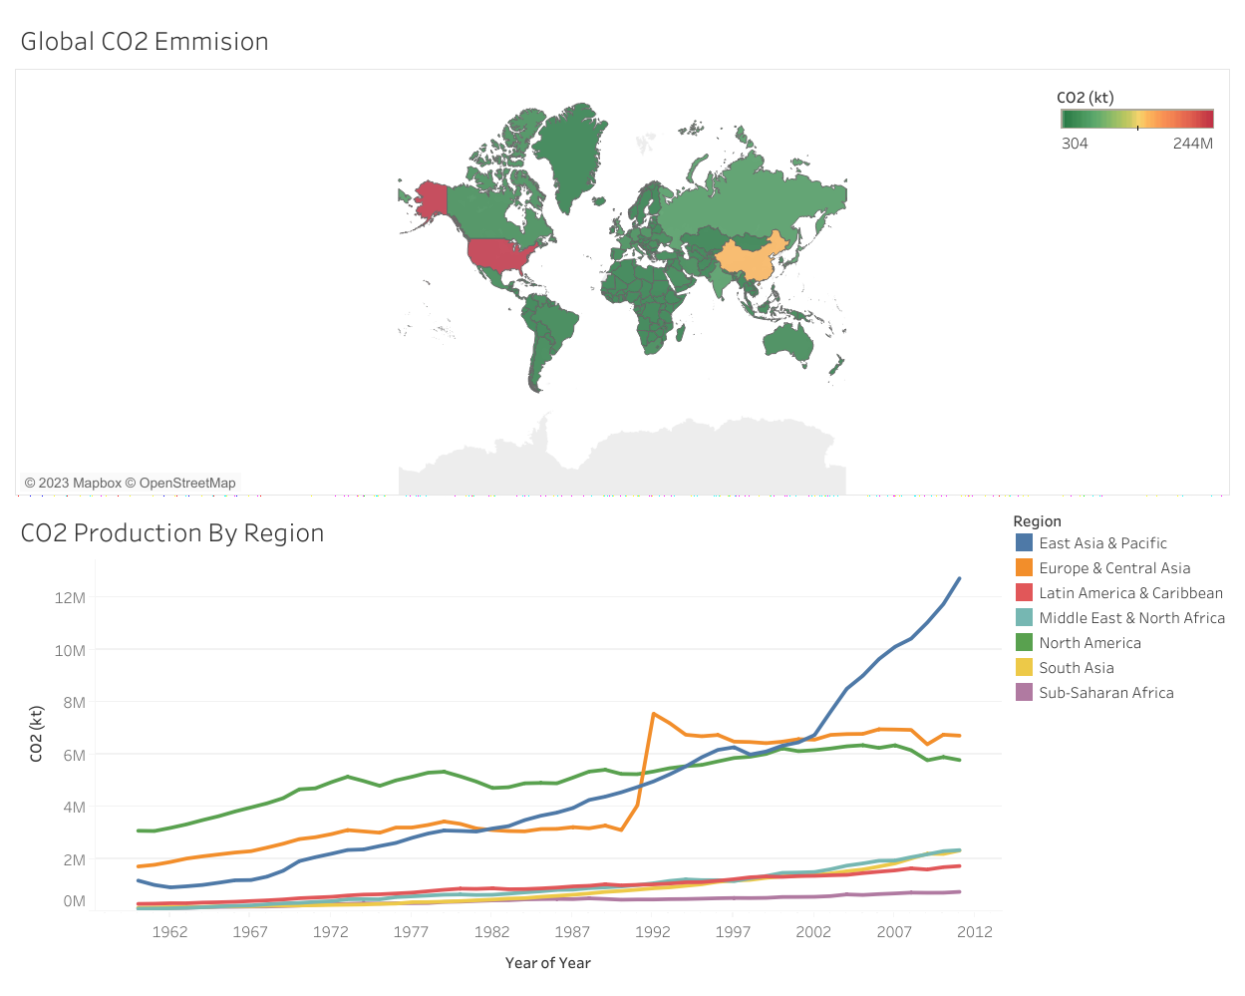

Slide 5
HOW?
Simple answers regarding the question of how can we control this rise in CO2 globally, That is;
To conduct awareness programs globally.
To Plant new tress and demote deforestation globally.
To Implement new regulation laws for industries that produce CO2 in large scale.

Slide 6
END

